Slide 1
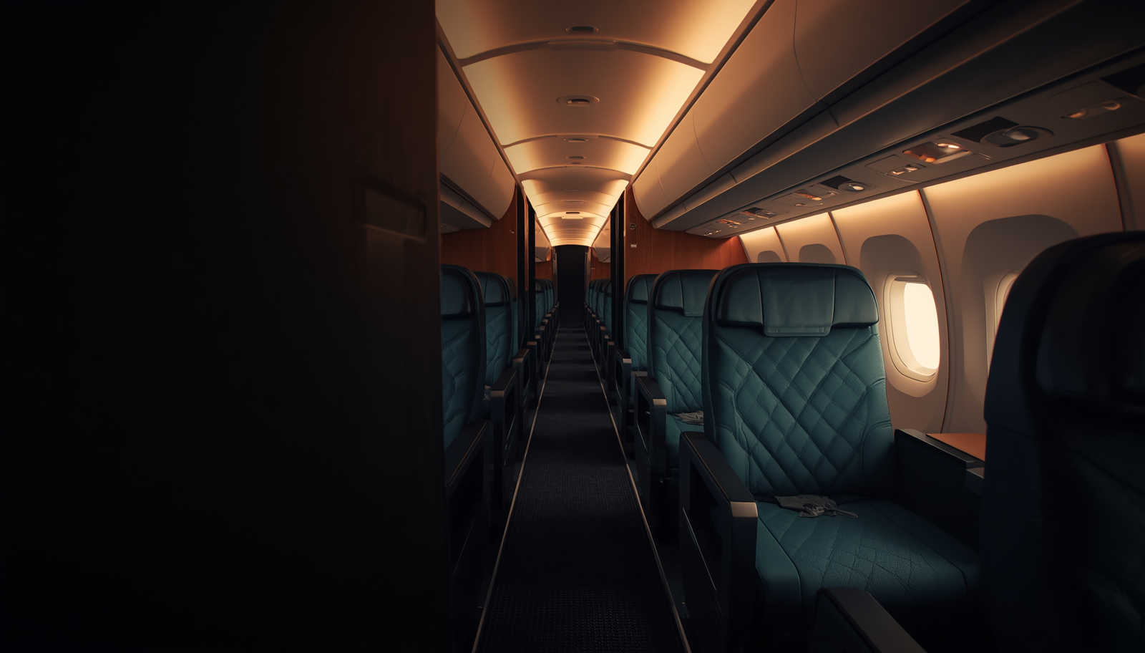

SEAT SELECTION GUIDE • 2025
Can I choose my seat
on Cathay Pacific?
Your guide to hassle-free seat selection on every flight
CALL +1-888-212-0809

Slide 2
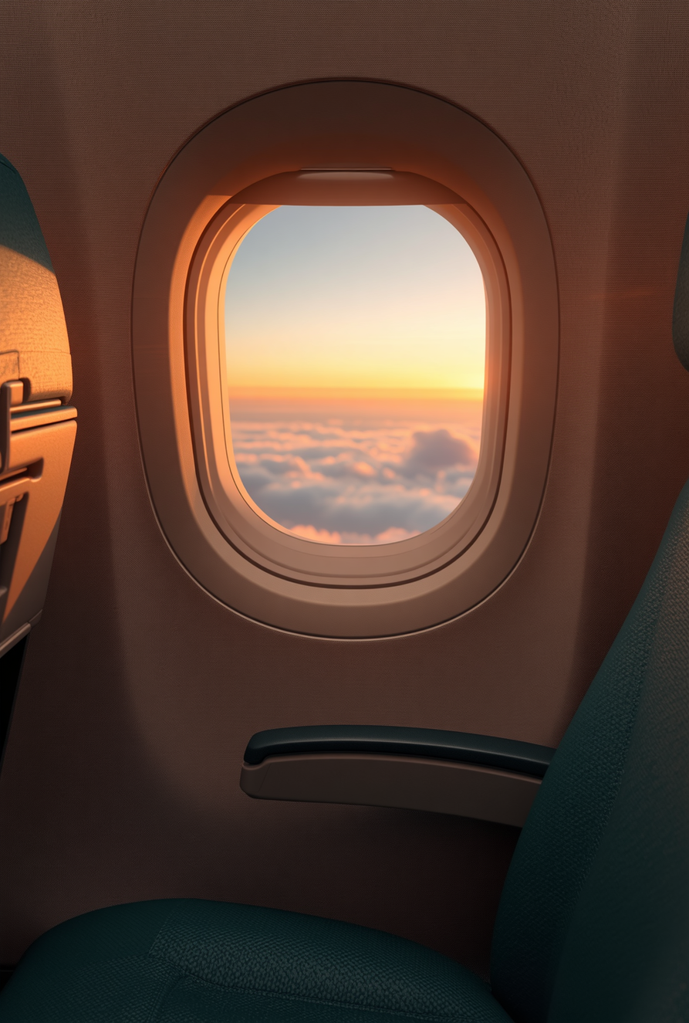
01 / INTRODUCTION
A better journey
starts before takeoff.
Cathay Pacific seat selection enhances your travel comfort by allowing you to pick your preferred seat ahead of time. Understanding when and how to select seats makes the journey smoother. This guide covers the essential process and policies, so you know exactly what to expect before you fly.

Slide 3
FREE OPTIONS
Does Cathay offer
free seat selection?
Cathay Pacific seat selection free
PREMIUM & STATUS
Premium-cabin passengers and eligible frequent flyers often receive complimentary seat choices.
FARE TYPE MATTERS
Economy passengers may have limited free options depending on the ticket purchased.
BOOK EARLY
Some early bookings include a free assignment. Check inclusions before paying a fee.

Slide 4
SMARTER BOOKING
CATHAY PACIFIC SEAT MAP
How do I avoid paying
for seat selection?
01
CHECK EARLY
02
CHOOSE THE RIGHT FARE
03
USE YOUR WINDOW
Review the seat map early and monitor availability regularly.
Book fares that include a seat, or use promotions that waive fees.
Join the loyalty program or select a seat during online check-in.

Slide 5
THE 48-HOUR WINDOW
48
How can I select my
flight seat for free?
HOURS BEFORE DEPARTURE
Cathay Pacific seat selection 48 hours prior can unlock more available seats. Use Cathay Pacific seat selection online tools, check in early, and review loyalty benefits to improve your cathay pacific seat selection experience without added fees.
BEST MOVE
Set a reminder for online check-in opening time.

Slide 6
WHEN SELECTION IS UNAVAILABLE
Why can’t I select my seat?
FARE RESTRICTIONS
Some fare classes do not include advance selection privileges.
BOOKING CHANNEL
Third-party agency bookings may limit direct seat-choice options.
OPERATIONAL CHANGE
Schedule changes or technical issues can temporarily block assignment.
Cathay Pacific seat selection international rules can vary by route and aircraft — check your booking again after any itinerary change.

Slide 7
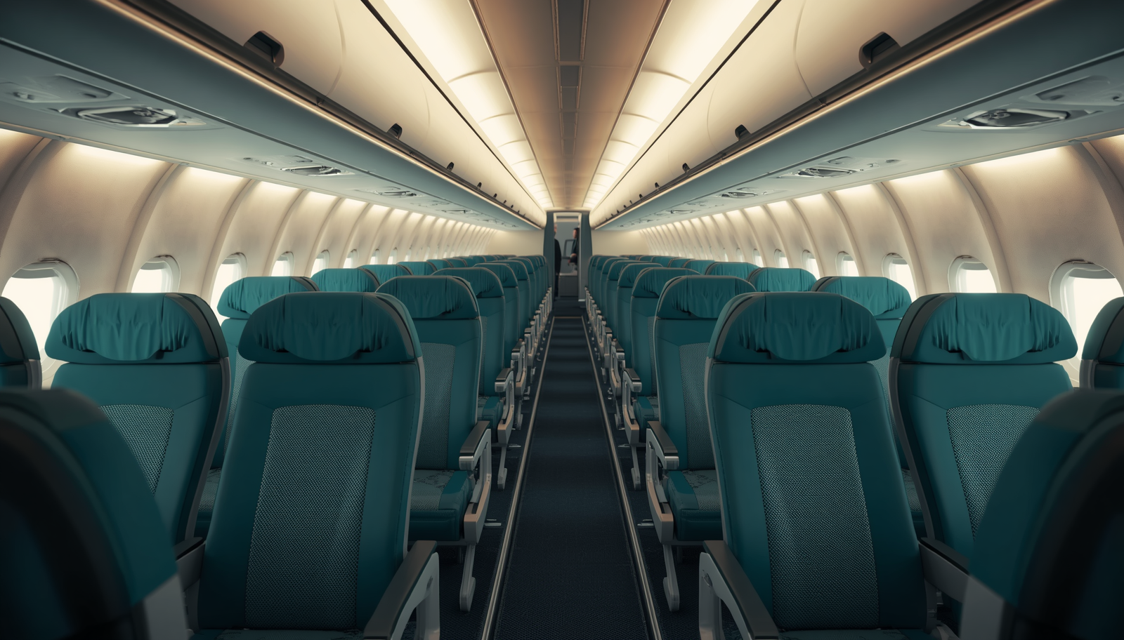
ECONOMY CABIN EXPLAINED
What is the 3:1:1 rule?
3
1
1
SEATS ON ONE SIDE
MIDDLE BLOCK
OTHER SIDE
Cathay Pacific seats Economy layouts vary by aircraft. Understanding the configuration helps balance comfort, aisle access and personal preference.

Slide 8
ADDITIONAL INFORMATION
Seat availability
is always moving.
Cathay Pacific seat availability updates dynamically online. Demand, timing, cabin and last-minute operational changes all affect what you see.
BOOK EARLY
Increase your chance of securing a preferred seat.
CHECK AGAIN
Premium cabins are flexible, but every cabin can change.

Slide 9
CONCLUSION
Choose sooner.
Travel better.
Understanding cathay pacific seat selection policies helps travelers make informed choices. Free options depend on fare type, timing and membership status. Use online tools within 48 hours of departure, understand layouts such as 3:1:1, and keep checking availability for a smoother booking experience.
01 CHECK YOUR FARE
02 OPEN THE SEAT MAP
03 RETURN AT 48 HOURS

Slide 10
READY TO PLAN YOUR JOURNEY?
Let’s find your
best seat.
WEBSITE
https://www.airflypolicy.com/
EMAIL
info@airflypolicy.com
PHONE
+1-888-212-0809
CALL NOW +1-888-212-0809

